Slide 1
Advanced Curriculum Manager Training COL Robinson (USA Ret) & 1SG Miller (USA Ret)
CLASS OVERVIEW/OBJECTIVES
Key Curriculum Manager Information
How to Build a Custom Exam
How to Administer the Personal Skills Map
What is Conover Online?
How to use the Components of the Conover System
How to use the Master Training Schedule

Slide 2
Key Curriculum Manager Info
HUSSAM- (757) 277-1646
Rusty – (318) 422-7841
CM HELP – www.jrotccmhelp@gmail.com
http://conoveru.com/jrotc-instructors
www://usarmyjrotc.com

Slide 3
1. To build a custom exam, click the Exam Builder button.

Slide 4
2. The Exam Builder window appears.

Slide 5
3. Drilldown to the Unit, Chapter, and Lessons to choose your question.

Slide 6
4. Click Add Question to begin adding your exam questions. Your questions appear under Exam Questions to the left of the window. Click Insert Question to add an exam question below the question you highlighted

Slide 7
5. To view a question, click the View Question button.

Slide 8
6. To delete a question, click the Delete Item button. The Delete Confirmation window appears.

Slide 9
7. To shuffle exam questions, click the Shuffle Items button.

Slide 10
8. Continuing adding/deleting questions until you have completed building your exam. When you are finished, click the Save Exam button and name your exam.

Slide 11
9. Your exam is saved. You can open the exam or delete an exam using the Open and Delete Exam buttons. 196

Slide 12
1. To administer a self-paced exam, click the Self Paced button.

Slide 13
2. Pick up to five exams, and then click the Next button. NOTE: You must select at least one exam to go to the next step.

Slide 14
3. Click the OK button.

Slide 15
4. Exam 1 students click in their clickers. The clicker number highlights on the grid to let students know they were added to the exam.

Slide 16
5. The instructor selects the Exam 2 radio button. The students then click in their clickers. The clicker number highlights on the grid to let students know they were added to Exam 2. NOTE: The instructor can go back and forth between exams to assign Cadets who missed clicking in, or clicked in the wrong exam. If students clicked into the selected exam by accident, they can click again to be removed from the current selected exam.

Slide 17
6. When all students click into their correct exams, click the Start Exams button.

Slide 18
7. The Exams Started Popup confirmation window displays. Click the OK button.

Slide 19
8. When exams start, question numbers will show under the clickers instead of exam numbers. a. Students click: • A-E to enter answers (make sure you do not use higher than MC5 questions) • F to jump to first unanswered question (if all questions are answered, question box jumps to last question and turns green) • H to go to next question • G to go to previous question

Slide 20
9. Explanation of box colors • Green: Completed Exam NOTE: When the Cadet finishes answering all questions in the exam, click the F button on the clicker to verify completion. • Blue: Answered question • White: Unanswered question NOTE: If you click in a second answer for an answered question, the box will turn to yellow then back to blue to let you know CM received your new answer. If your answer is outside the acceptable answer range, the box will turn red then white which means it will set the question to unanswered.

Slide 21
When all done, click the End Exams button. You will be prompted if someone has not finished all their questions. If you still choose to end exams, unanswered questions will be recorded and will show as no response in the Instructor Summary report.

Slide 22
1. To add a new question, select Exams from the Menu button options. Click the Exam Builder button.

Slide 23
2. Click the Launch Question Editor button.

Slide 24
3. Click the “+” to expand the tree.

Slide 25
4. Click the lesson title to display the list of question types available (FIT, Vocabulary, or Instructor Designed).

Slide 26
5. New questions built by instructors will be added to the Instructor Designed sub-folder. To add a new question, click the Add Question button.

Slide 27
6. The Setup Question window appears. In the left corner, select the type of question you want to add from the list (for example, “MC4 No Graphic” will display a Multiple Choice question with four choices).

Slide 28
7. Type in your question and answers. Check the box next to the correct answer.

Slide 29
8. After the question is added, click the Red Question mark in the top left corner, then click Save and Close.

Slide 30
You can access the Question Display Preference option from either within your lesson presentation or from the Lesson List screen. Click the Menu button and select the Show Prefs option.

Slide 31
Skills Map
How to Administer the Personal Skills Map

Slide 32
1. From the Lesson List screen, click the Menu button, then select Exams.

Slide 33
2. Select the Instructor Led button. The Exam Menu List opens.

Slide 34
3. Select Personal Skills Map from the list. Note: When this is selected it will automatically start the Personal Skills Map

Slide 35
4. Answer all questions in the Personal Skills Map. 5. When finished, exit the presentation by clicking the Back button. You will then be returned to the Lesson List screen. 346

Slide 36
6. From the Lesson List screen, click the Menu button, then select Reports. The Reports Application screen displays.

Slide 37
7. Click the Personal Skill Map Quick Print button to generate the report.

Slide 38
8. Select the desired Personal Skills Map Presentation, then click the OK button. Your graph report will now be sent to the printer. Note: Selecting the Per Student option will print a Personal Skills Map for each student.

Slide 39
Graph Report Quick Print

Slide 40
Success Profiler The Success Profiler report generates a Personal Skills Map .csv file to use with Success Profiler program.

Slide 41
To Generate a Success Profiler Report Locally:
1. Click the Success Profiler button. The Select Presentations window displays.
2. Select the desired presentation and then click the OK button.
3. Click the Save button and give the report a name.
4. The *.csv file will automatically be saved in the Success Profiler program folder.
5. Exit the Report Manager.
6. On the CM Menu, click Applications and then click Success Profiler.
7. Click on Administration Program.
8. Enter the Admin Password “Conover”.
9. On the Main Menu click Import Data from CM.
10.Click Import Cadet Data from CM button.
11.Select the file you saved in Step 3 above.
12.Click on the text that says “Click here for current list of Groups”.

Slide 42
To Generate a Success Profiler report Locally:
13.Select the Group of Cadets and hit Enter.
14.Enter the User Program (optional) and hit Enter.
15.The data for your Cadets will be imported into the Success Profile program. Please refer the Success Profiler User Manual for additional information.
Note: All students belonging to the report roster must have unique student ID’s.
Another option to analyze your personal skills map data is to upload it to the Conover Online website.

Slide 43
To Generate an Online PSM Report: 1. Click the Online PSM button located on the Main Reports tab. The Online PSM-Personal Skills Map Exam Required window displays. 2. Click the OK button. 352

Slide 44
The Select Presentations window displays.
3. Select the desired presentation that you wish to view and click the OK button.
The Criteria window displays.
4. Click the Yes button.
The Generation Successful window displays.
5. Click the OK button.
The Upload Report Prompt displays.
6. Click Yes to upload the Online PSM Report to Conover Online website.

Slide 45
Instructions for uploading the Online PSM Report to the Conover Online website:
a. Login to Conover Online website.
b. Select Upload on the webpage.
c. Navigate to “<drive>Online Reports”. (REMEMBER THIS)
d. Select an Online PSM Report data file for upload.
Important: Only select a file that follows this naming convention: “Online Psm_Class…” for upload.
NOTE: Click on the link below:
http://conoveru.com/videos/internet/ajrotc/extra-videos/import-psm-from-cm/
to view Conover's help video on how to import the PSM report to their system.

Slide 47
Conover Online
Conover Online is a web-based assessment and curriculum system that covers four unique areas:
1.Vocational Assessment
2.Self-Determination
3.Social/Emotional Learning
4.Independent Living Skills

Slide 48
Common Problems & Questions Here you will find answers to common problems and questions.
How to use the Report Generator
How do I turn on the audio or text-to-speech
I get a 500 error when using Conover Online.
How do I preview a unit before making an assignment
How do I reassign an assignment or activity
How do I unassign an assignment or activity to get my credit back
How do I view User or Student reports
How do I access a User’s or Student’s assignments
How does a user log into Conover Online
How do I make an assignment for my user or student
How do I create a User or Student Account in Conover Online
How do I delete a user or account
How do I change the password for a user or administrator account
How do I reset my password

Slide 49
Comprehensive Training Videos
Conover Online Welcome Videos - These are the videos that the user sees the first time they access Conover Online
Introductory Video - These videos will give you an overview of the products included with Conover Online
Accessing Conover Online Professional - These videos will show you the basics of using accessing Conover Online
Website Layout - These videos will give you an overview of the Conover Online website
The Administrator Account - These videos will show all of the options available to an Administrator
The User Account - These videos will show all of the options available to an individual user
Manage Assignments - These videos will show how to make assignments for your users
How Personal Responsibility Works - These videos will show how Personal Responsibility works with a user
How The Success Profiler Works - These videos will show how The Success Profiler works with a user
The Viewer Account - These videos will show all of the options available to an Viewer

Slide 50
How to use the Report Generator

Slide 51
Next, choose Report Generator from the options listed on the left-hand side of the screen.

Slide 52
There are a few options available to you. You can do a report for a single user.

Slide 53
If you are a System Administrator, you can select System Wide and do a report for all users in the system.

Slide 54
You can select a group of users.

Slide 55
Once you have chosen who to make a report for, you will need to select your data range. If you do not select a date range, all dates will be used.

Slide 56
Next, choose which programs you would like included in your report.

Slide 57
Choose Generate Report to create your report.

Slide 58
Your report will be processed in the background. This can take some time depending on which options you selected and how many users you have in the system.

Slide 59
Once our report is ready, you will be emailed a link. Make sure to check your SPAM folder in case you do not receive the email.

Slide 60
To reassign an activity in The MECA System, select the blue Show items available for reassignment button. This button will only be available if there are activities available to reassign.

Slide 61
This will bring up a list of the activities that are available to reassign. With MECA, you can reassign any unit once it has been started. You can see the percent complete next to the assignment name. If you re-assign a career area, you will lose all progress in the LAP, Career Planner and Work Sample. Each assignment will be closed, the report data saved.

Slide 62
Workplace Readiness Once a user completes an activity in Workplace Readiness, a blue box will highlight the assignment to let you know that the assignment has already been completed, but you can reassign it. All you have to do is check the box and save the assignment.

Slide 63
Personal Responsibility Once a user completes an activity in Personal Responsibility, a blue box will highlight the assignment to let you know that the assignment has already been completed, but you can reassign it. All you have to do is check the box and save the assignment.

Slide 64
The Success Profiler Once a user completes an activity in Workplace Readiness, a blue box will highlight the assignment to let you know that the assignment has already been completed, but you can reassign it. All you have to do is check the box and save the assignment.

Slide 65
Functional Skills System To reassign a unit in Functional Skills, find the unit that you want to reassign. Units that are assigned are highlighted in green.

Slide 66
Next, select the blue Reassign button to reassign the unit.

Slide 67
Master Training Schedule

Slide 68
Master Training Schedule

Slide 69
Master Training Schedule

Slide 70
Master Training Schedule

Slide 71
Master Training Schedule

Slide 72
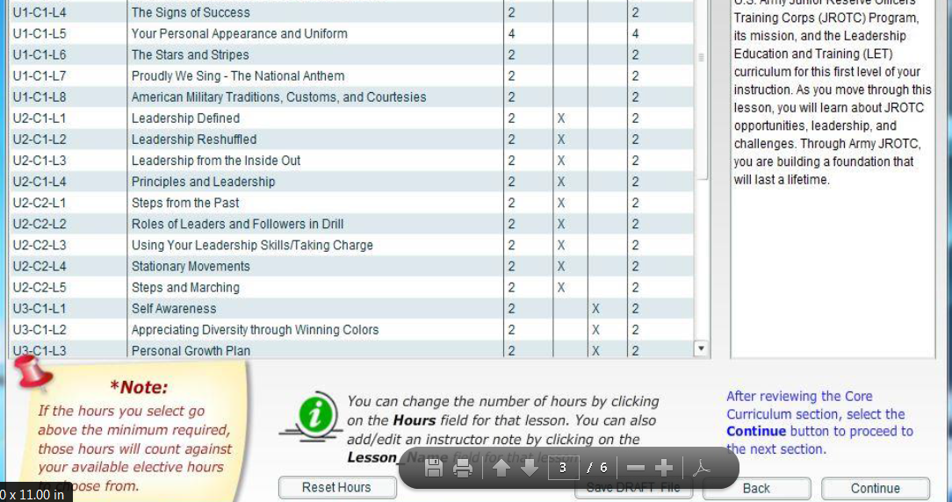
Master Training Schedule

Slide 73
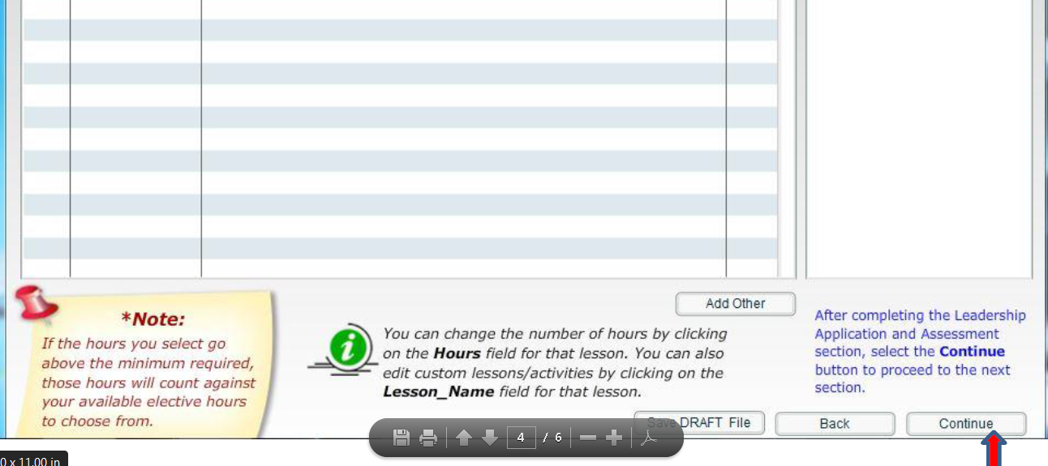
Master Training Schedule

Slide 74
Master Training Schedule

Slide 75
Master Training Schedule

Slide 76
Master Training Schedule

Slide 77
Questions
?

